Slide 1
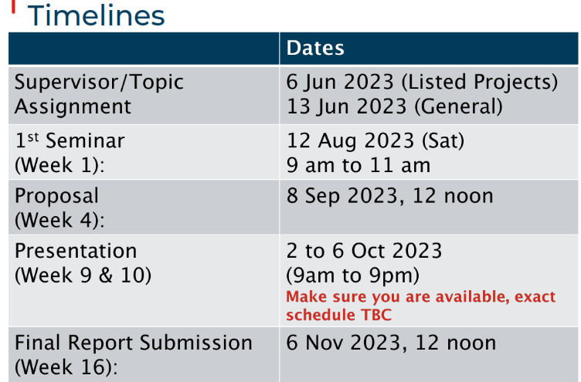

Slide 2
ANL488 BA Applied Project
Supervisor Meeting #1
Name of Student
Progress:
 | 10% |  | 20% |  | 30% |  | 40% |  | 50% |  | 60% |  | 70% |  | 80% |  | 90% |  | 100%

Slide 3
Progress Report
Progress since last meeting
Finished exploratory data analysis on dataset
Identified 2 new data sources

Slide 4
Updates
Goals until next meeting
Create 2-3 more visualizations
Consolidate and prepare data for analysis & modelling

Slide 5
Learning
Use of lemmatization in text-preprocessing
Dimensionality reduction techniques

Slide 6
Challenges
Difficult to check quality of data after pre-processing

Slide 7
Concerns
Difficult to check quality of data after pre-processing

